Slide 1
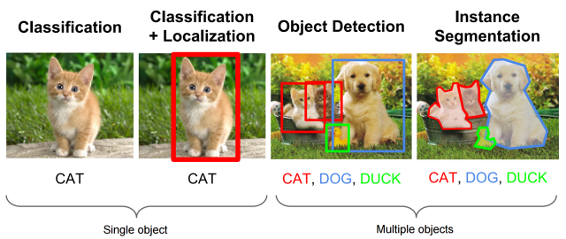
Localization: Predicting Where the Objects Are
Unlike classification (which says "what" is in the image), localization identifies "where" the object is.
We represent the location of an object using a Bounding Box.
Coordinates: Standard bounding boxes use a 4-value vector: [x, y, w, h].
x, y: The center (or top-left) coordinates of the box.
w, h: The width and height of the box relative to the image size.

Slide 2
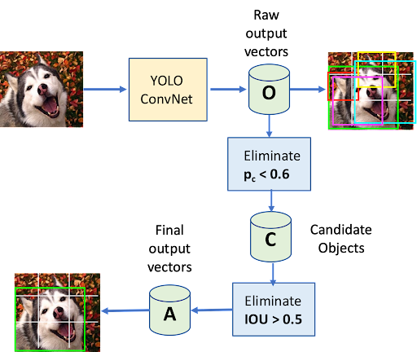
YOLO: Real-Time Detection Logic
YOLO is a single-stage detector that views the entire image once to predict both boxes and classes.
It is designed for high-speed, real-time performance on video streams.
Evolution: The architecture has evolved from YOLOv8 to the latest YOLOv11 for improved accuracy and efficiency.
The model divides the image into a grid and predicts probabilities for each grid cell.

Slide 3
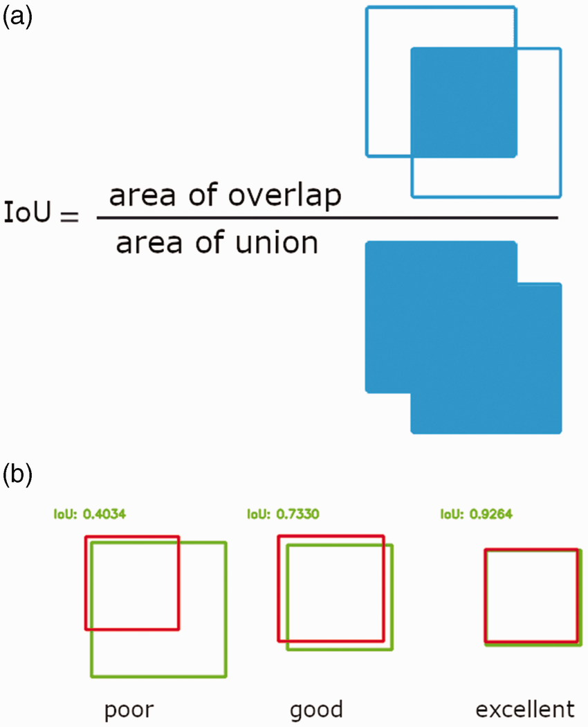
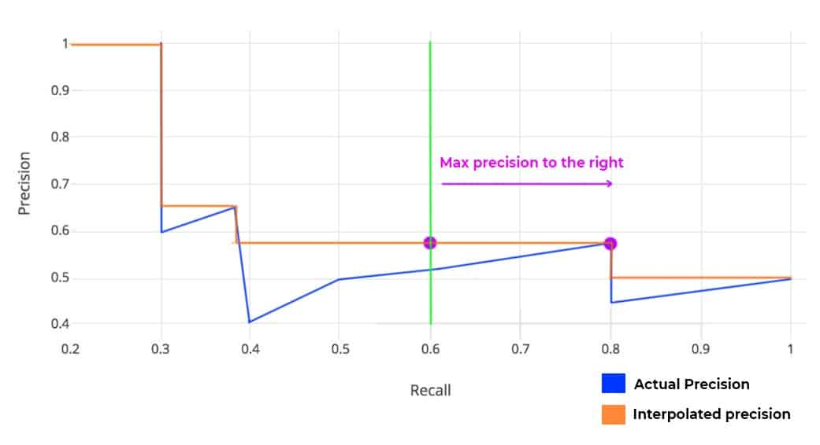
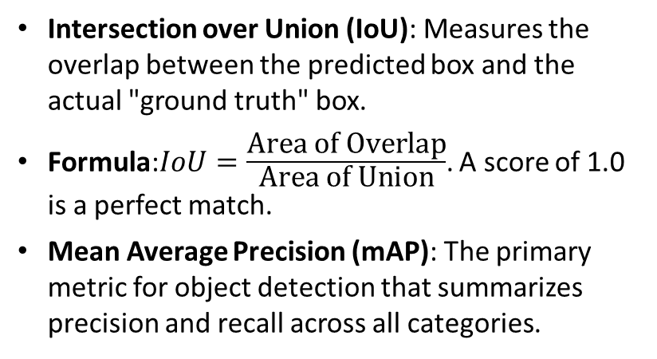
Evaluating Performance: IoU and mAP
Intersection over Union (IoU): Measures the overlap between the predicted box and the actual "ground truth" box.
Formula:$IoU=\frac{\text{Area} \text{of} \text{Overlap}}{\text{Area} \text{of} \text{Union}}$. A score of 1.0 is a perfect match.
Mean Average Precision (mAP): The primary metric for object detection that summarizes precision and recall across all categories.

